Slide 2
Deep Dive into Safe SharePoint Branding in Office 365 Using Repeatable Patterns and Practices
Vesa Juvonen
Senior Program Manager
Office 365, Microsoft

Slide 3
Agenda
Introduction
Themes and other branding techniques
Building response experiences
Controls and other UX elements

Slide 4
Recommendations
Avoid custom master pages
Use Office 365 themes when possible
Alternate CSS for advance settings and responsive
JavaScript Embed for control and UX components
Notes:
Vesa

Slide 5
“You do not brand Outlook or Word, why do you need to do branding on collaboration sites?”
Good question…
Applying branding is absolutely supported and understandable for intranet portals, but what about collaboration sites? It is recommended to consider the cost versus gain.

Slide 6

How to minimize future maintenance?
Use alternate methods rather than master pages
All changes to OOB master pages are provided to your sites automatically without need to modify custom code
Avoid feature framework element usage
Many feature framework elements will create dependency to xml files on the disk , which then cannot be removed easily (think “Content Migration”)
Sandbox solutions will also impact future maintenance costs of the deployment
Notes:
Vesa

Slide 7
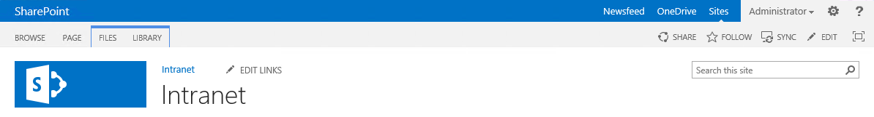
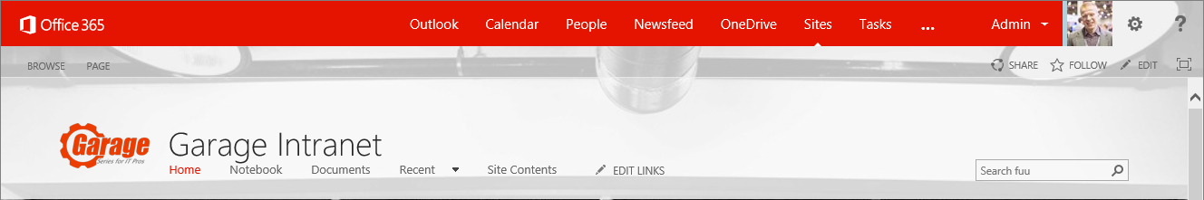
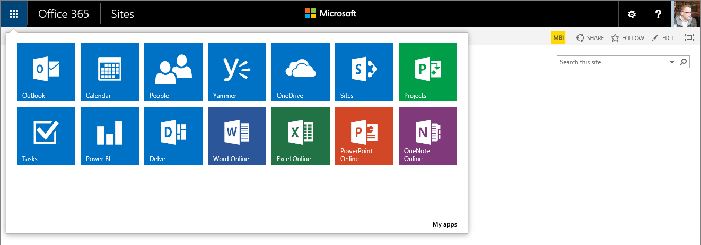
Constant evolution of the user experience
Notes:
App launcher

Slide 8
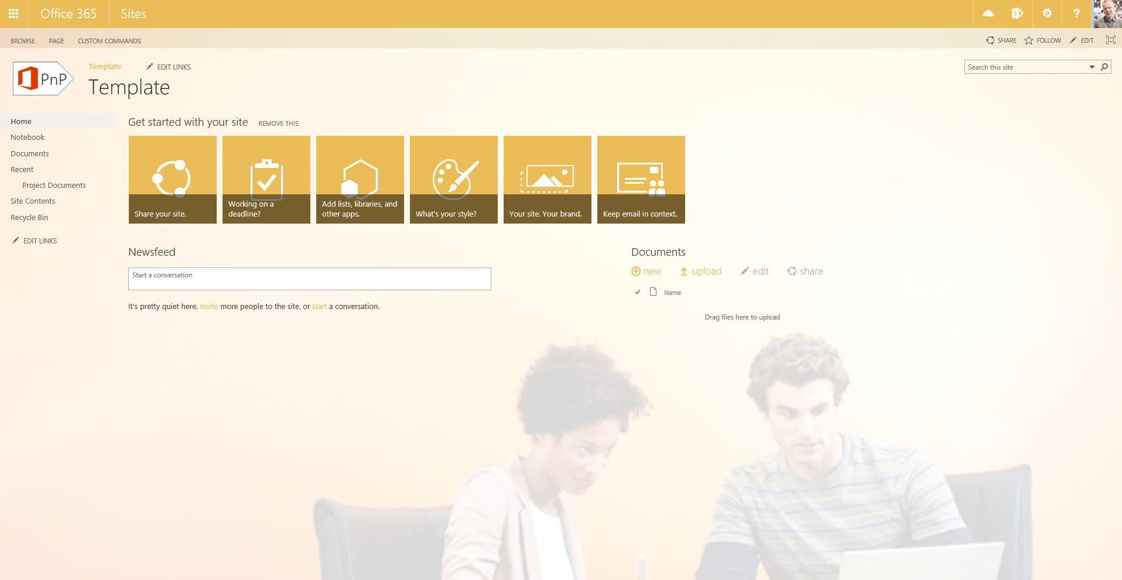
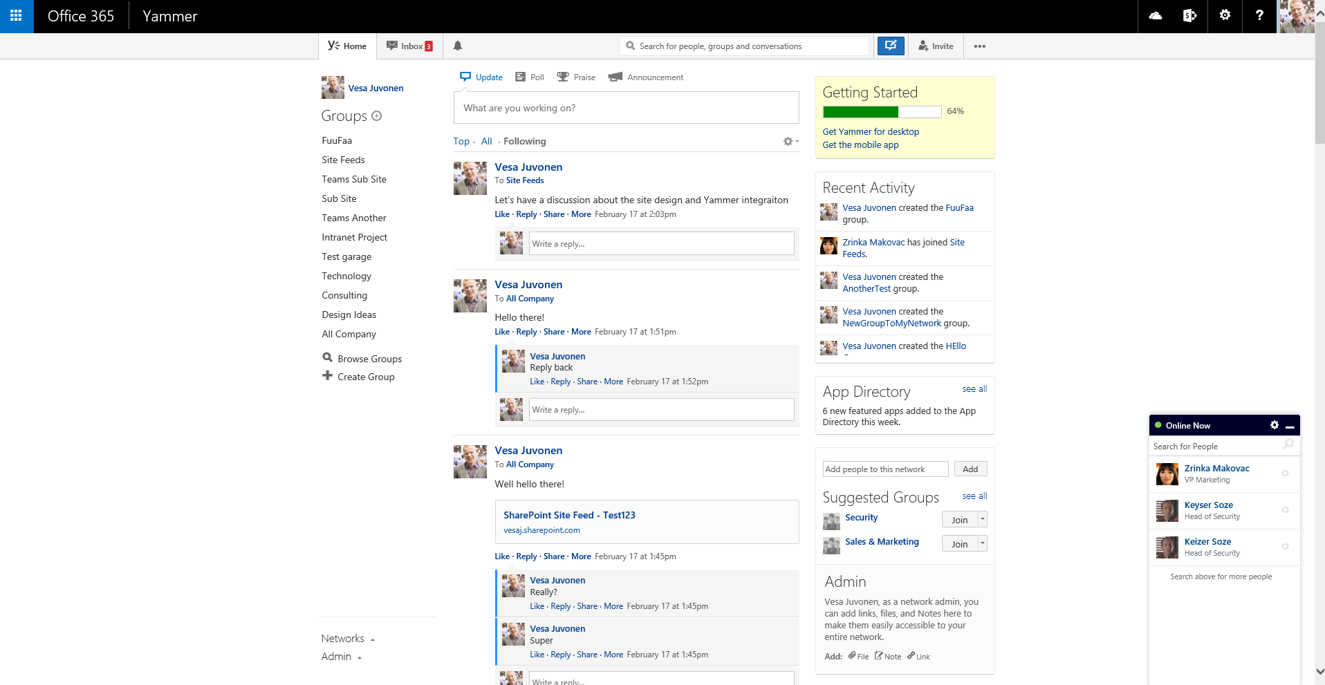
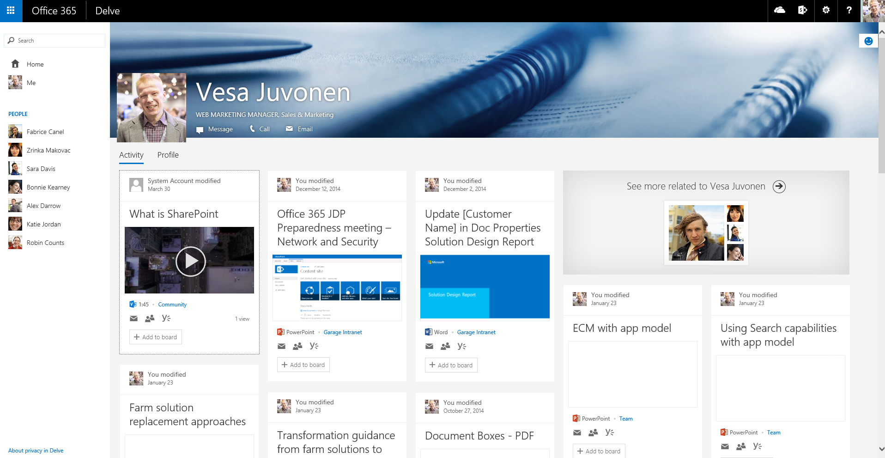
Office 365 services and branding

Slide 9
What is the challenge with custom master page?
New custom master page is created by copying oob master or starting from scratch using oob master as the reference
Significant differences on the outcome unless custom master page been updated during the releases.
contoso.master
contoso.master
contoso.master
master
Version 15.x
master
Version 15.x
master
Version 15.x
<< Copy >>
Custom Master
Oob Master
Seattle.master
Seattle.master
Seattle.master
master
Version 15.x
master
Version 16.x
master
Version 16.x.1
Time
Service updates for introducing new version of the out of the box master page with some new capabilities or bug fixes.
Notes:
Vesa
Risk is that for sites created from the time WE updated the service until the time YOU updated your Templates, these sites will NOT have all of the features

Slide 10
“But I have always customized my sites with custom master, what has changed?”
Nothing
Actually this similar maintenance challenge exists in on-premises and across the version upgrades as well. Concentrate on what’s truly needed.
Notes:
Vesa

Slide 11
“How should I get my files uploaded to the SharePoint sites? Using sandbox?”
No.
It is recommended to upload files as part of the site provisioning process remotely using so called “remote provisioning” pattern directly using remote APIs. Will not cause any cross file dependencies.
Notes:
Vesa

Slide 12
“I have an intranet portal and I need to do heavy branding customizations!”
Absolutely fine.
Key point is to understand the impact of the chosen pattern. Custom master pages are completely supported, you might want to use alternative approaches if possible.
Notes:
Vesa

Slide 13

Themes
What
Provide user branding elements without introducing master page or page layout elements
Why
Continue using out of the box master pages, but introduce customer specific branding elements
How
Use theming engine for introducing color, fonts and background images for sites
Notes:
Steve

Slide 14
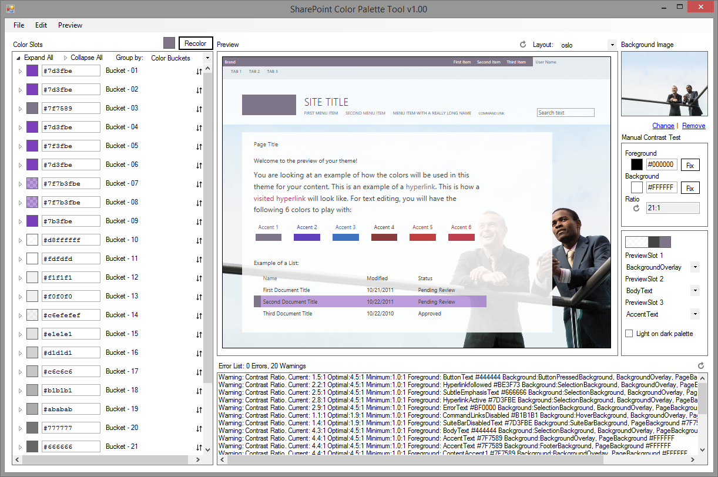
SharePoint Color Palette Tool v1.00
Free downloadable tool to create custom themes based on branding requirements from Microsoft download site
Can be used to create themes in matter of minutes with company colors and images
Notes:
http://www.microsoft.com/en-us/download/confirmation.aspx?id=38182
Steve

Slide 15
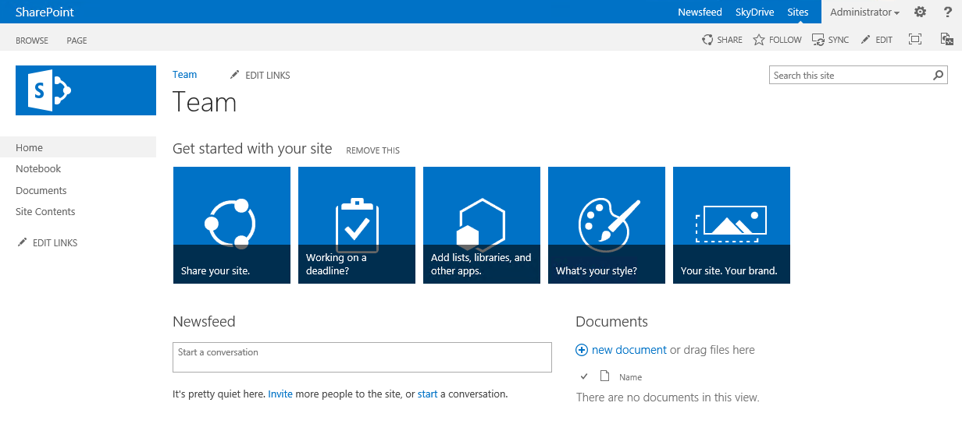
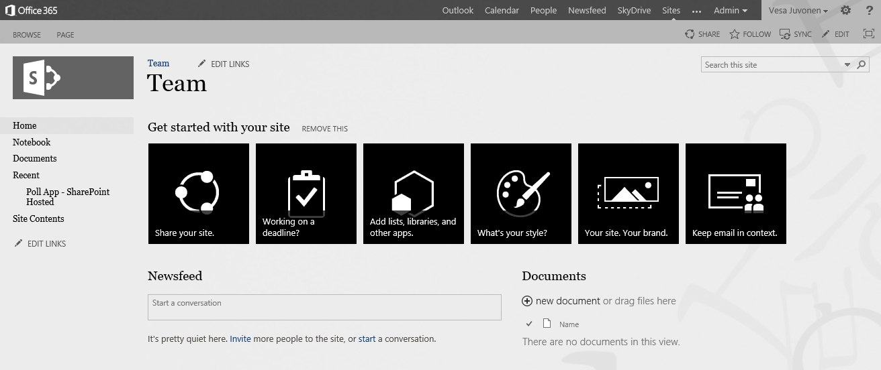
Handling themes from SP Apps
1
Provider Hosted Apps
SharePoint Service
CSOM
3
Upload needed files
Set theme to site
(Set master page to site)
Theme elements
2
Color file
Font file
Background image
(Master page)
Notes:
Steve App is started from the web by end user or process is started during provisioning
App side has the needed theme elements and other assets for sites, which will be published
App drives the modification of the host web by applying the needed customizations to host web

Slide 16
Demo SharePoint Themes
https://github.com/OfficeDev/PnP/tree/master/Samples/Branding.DeployCustomThemeWeb

Slide 17
Adding alternative styling for host web
What
Provide alternate CSS styling elements to the web by adding custom style elements to the page rendering process
Why
To provide more comprehensive changes on the page layout compared to what themes can do without introducing a custom master page
How
Use the AlternateCSSUrl web object property, which was introduced as new capability in the 2014 April CU for SharePoint 2013
Notes:
Vesa

Slide 18
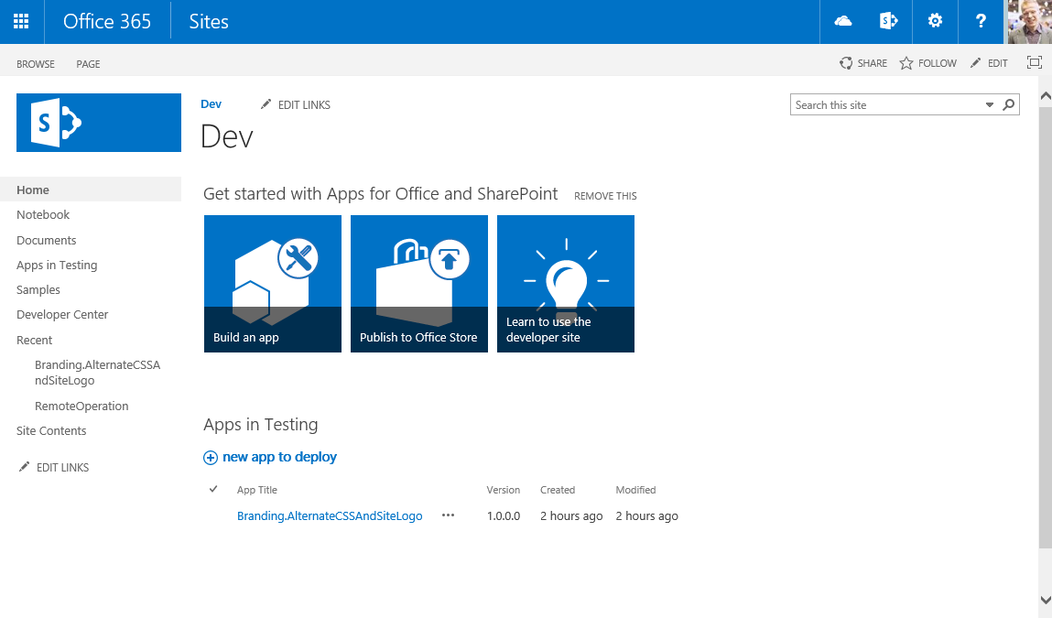
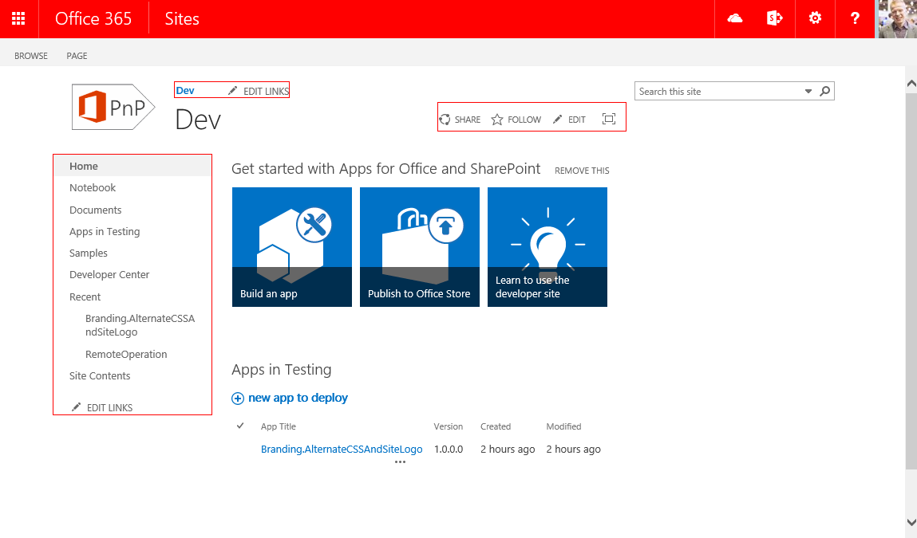
Controlling CSS from App
1
Provider Hosted Apps
SharePoint Service
CSOM/REST
3
Upload CSS
Set alternate CSS for the site
Assets
2
CSS file
Images
Notes:
Steve App is started from the web by end user or process is started during provisioning
App side has the needed theme elements and other assets for sites, which will be published
App drives the modification of the host web by applying the needed customizations to host web

Slide 19
Demo Using alternate css and custom logo
https://github.com/OfficeDev/PnP/tree/master/Samples/Branding.AlternateCSSAndSiteLogo

Slide 20
Office 365 Themes
What
Control high level branding settings cross Office 365 services
Why
Provide branding consistency across all services, like Yammer, Delve or OneDrive for Business
How
You can control company wide default branding settings from the Office 365 administration services
SharePoint sites use Office 365 theme if site specific theme is not applied
Personal theming option can be disabled by tenant administrator, if needed (coming)
Notes:
vesa

Slide 21
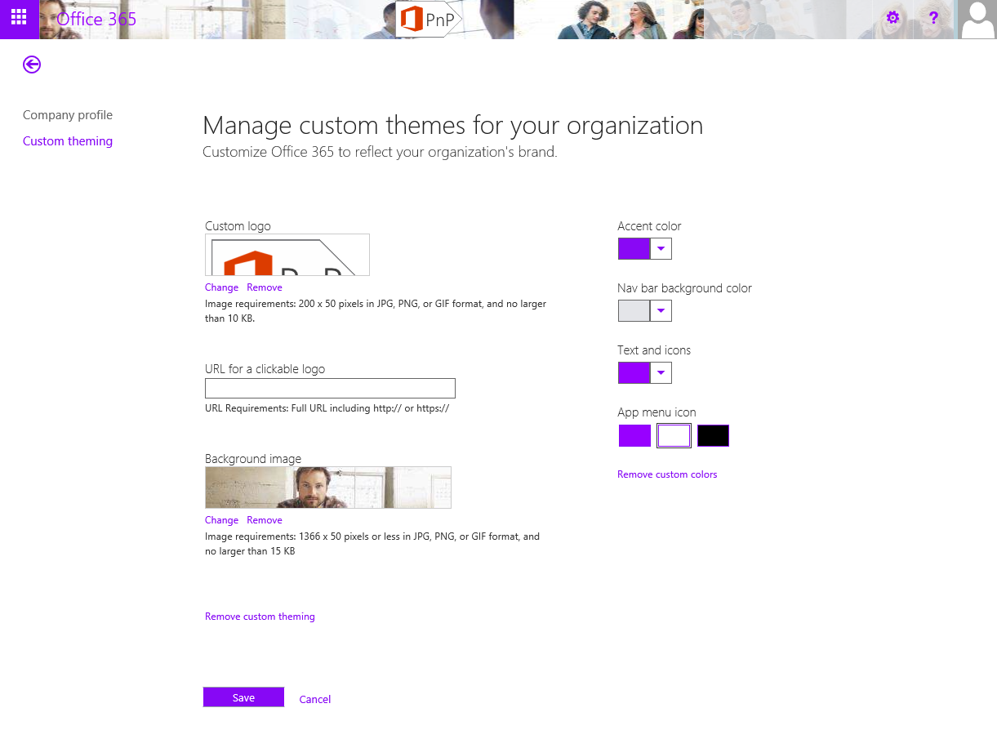
Controlling themes for Office 365
Notes:
vesa

Slide 22
Demo Office 365 Themes

Slide 23
Responsiveness in SharePoint?
What
Requirement to have responsive UI for different devices in SharePoint
Why
To support multiple different devices and screen sizes
How
You can always create a new custom master page, but that has then impact on the overall costs of your deployment
You can use out of the box and embed custom CSS with alternate CSS property
Making master page responsive does not however make all web parts responsive
Notes:
vesa

Slide 24
New portal experiences are natively implemented as responsive in Office 365
We are looking to have native responsive experience with all new capabilities introduced to Office 365
Notes:
Vesa

Slide 25
Demo Transforming out of the box master pages responsive with custom CSS
https://github.com/OfficeDev/PnP/tree/dev/Samples/Branding.InjectResponsiveCSS

Slide 26

Branding options for SharePoint sites
Office 365 Themes
Theme
Alternate CSS
Custom Master Page
Can be used to centrally control branding cross all services in the Office 365
Limited settings currently
Can be overridden in site level
Only in Office 365, not in on-premises
Can be used to control branding, fonts and background image of the sites
Configuration applied to each site
Can be used to override whatever CSS settings
Control to color, fonts and even layout settings
Configuration applied to each site
Can be used to provide responsive user experiences
Full control on how the site is rendered
Applied one by one to each site, except for publishing sites
Any updates to oob master pages are not automatically reflected on the sites
Options
Support
only
Flexibility
Fair
Average
Good
Unlimited
Cost impact (short and long term)
Notes:
Vesa & Steve Dialog

Slide 27
What about custom controls in my custom master page for UX?
JavaScript Embedding provides us capability to provide UI level changes as well without need of custom master pages…
Notes:
Vesa

Slide 28
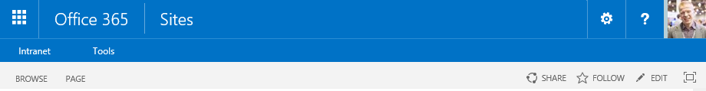
Web control to client side solution
Old model
Custom web control on master page
Full trust solution deployment with its implications
New model
Client-side rendering using JavaScript on the site
Taking usage of the greatly enhanced CSOM and REST APIs in SharePoint
Dynamic update of the capability without maintenance window

Slide 29
JavaScript embedding for web control replacement
Association of JavaScript embedding (user custom action) to the site, so that code is executed during site processing
SharePoint Service
1
Provider Hosted Apps
CSOM / REST
2
<<Reference>>
js
3
UX component or elements are rendered using CSOM with JavaScript stored either in SharePoint or centrally outside fo the SharePoint, for example in provider hosted app site.
Notes:
Vesa

Slide 30
Demo Embed second level navigation
https://github.com/OfficeDev/PnP/tree/master/Samples/OD4B.NavLinksInjection

Slide 31
“JavaScript embedding could be impacted if elements in master are changed?”
Correct.
Be aware of any dependency that you take to specific DOM elements. If they change, you could have to rework your scripts.
Notes:
Vesa

Slide 32
Summary
Avoid custom master pages
Use Office 365 theme when possible
Consider using Alternate CSS
JavaScript Embed for control and UX components
Notes:
Vesa

Slide 33

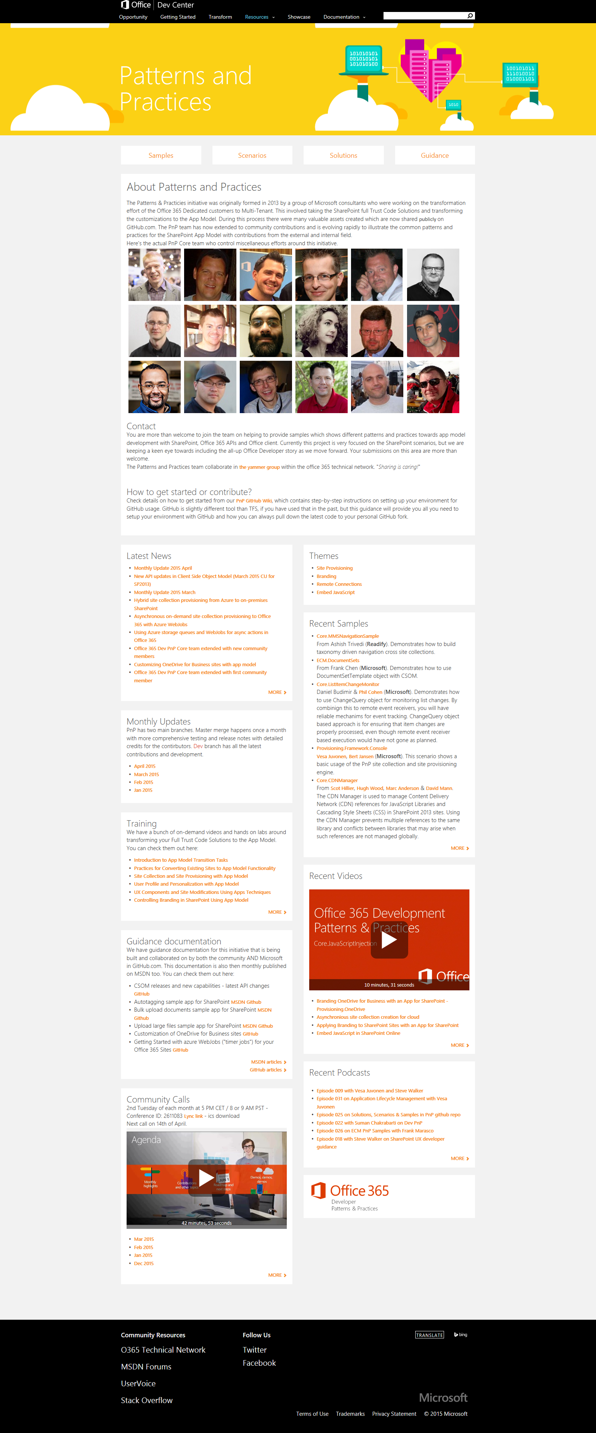
“Sharing is caring”
aka.ms/OfficeDevPnP
aka.ms/OfficeDevPnPYammer
aka.ms/OfficeDevPnPMSDN
aka.ms/OfficeDevPnPVideos
aka.ms/OfficeDevPnPTraining

